Slide 1
ICE-5121: MACHINE LEARNING
Naïve Bayes Classifier Algorithm
Notes:
‹#›
Optimisation of the Beer Distribution Game

Slide 2
Naïve Bayes Classifier Algorithm
‹#›
Naïve Bayes (NB) algorithm is a supervised learning algorithm, which is based on Bayes theorem and used for solving classification problems.
It has been successfully used for many purposes, but it works particularly well with natural language processing (NLP) problems. It is mainly used in text classification.
It is a probabilistic classifier, which means it predicts on the basis of the probability of an object.
Some popular examples of Naïve Bayes Algorithm are spam filtration, Sentimental analysis, and classifying articles.
Notes:
Optimisation of the Beer Distribution Game
‹#›

Slide 3
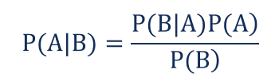
Bayes' Theorem
‹#›
The Bayes’ theorem is expressed in the following formula:
P(A|B) – The probability of event A occurring, given event B has occurred also called Posterior probability
P(B|A) – The probability of event B occurring, given event A has occurred also called Likelihood probability
P(A) – The probability of event A
P(B) – The probability of event B
Notes:
Optimisation of the Beer Distribution Game
‹#›

Slide 4
Assumptions Made by Naïve Bayes
‹#›
The fundamental Naïve Bayes assumption is that each feature makes an:
Independent
Equal
Notes:
Optimisation of the Beer Distribution Game
‹#›

Slide 5
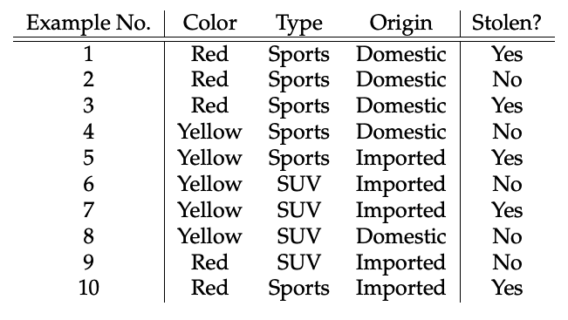
Naïve Bayes Example
‹#›
The dataset is represented as below.
Here in our dataset, we need to classify whether the car is stolen, given the features of the car.
Notes:
Optimisation of the Beer Distribution Game
‹#›

Slide 6
Naïve Bayes Example
‹#›
Concerning our dataset, the concept of assumptions made by the algorithm can be understood as:
We assume that no pair of features are dependent. For example, the color being ‘Red’ has nothing to do with the Type or the Origin of the car. Hence, the features are assumed to be Independent.
Secondly, each feature is given the same influence(or importance). For example, knowing the only Color and Type alone can’t predict the outcome perfectly. So none of the attributes are irrelevant and assumed to be contributing Equally to the outcome.
Notes:
Optimisation of the Beer Distribution Game
‹#›

Slide 7
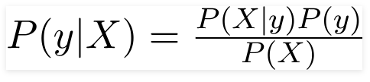
Naïve Bayes Example
‹#›
So we want to classify a Red, Domestic, SUV car is getting stolen or not. Note that there is no example of a Red Domestic SUV in our data set.
According to this example, Bayes theorem can be rewritten as:
The variable y is the class variable (stolen?), which represents if the car is stolen or not given the conditions. Variable X represents the features.
Notes:
Optimisation of the Beer Distribution Game
‹#›

Slide 8

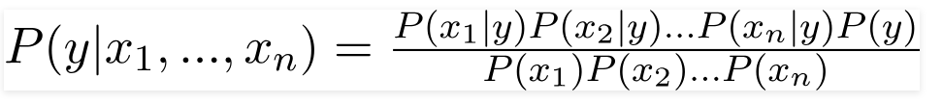
Naïve Bayes Example
‹#›
X is given as:
Here x1, x2…, xn represent the features, i.e they can be mapped to Color, Type, and Origin.
By substituting for X and expanding using the chain rule we get:
For all entries in the dataset, the denominator does not change, it remains static. Therefore, the denominator can be removed.
Notes:
Optimisation of the Beer Distribution Game
‹#›

Slide 9


Naïve Bayes Example
‹#›
Then we get the following proportionality condition:
In our case, the class variable(y) has only two outcomes, yes or no. There could be cases where the classification could be multivariate. Therefore, we have to find the class variable(y) with maximum probability.
Using the above function, we can obtain the class.
Notes:
Optimisation of the Beer Distribution Game
‹#›

Slide 10
Naïve Bayes Example
‹#›
The posterior probability P(y|X) can be calculated by first, creating a Frequency Table for each attribute against the target.
Then, creating the frequency tables to Likelihood Tables.
Finally, use the Naïve Bayesian equation to calculate the posterior probability for each class.
The class with the highest posterior probability is the outcome of the prediction.
Notes:
Optimisation of the Beer Distribution Game
‹#›

Slide 11
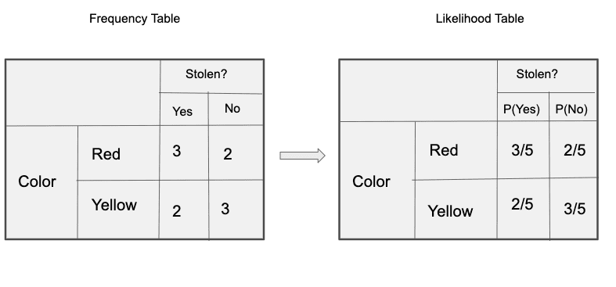
Naïve Bayes Example
‹#›
Below are the Frequency and likelihood tables for all three predictors.
Frequency and Likelihood tables of ‘Color’
Notes:
Optimisation of the Beer Distribution Game
‹#›

Slide 12
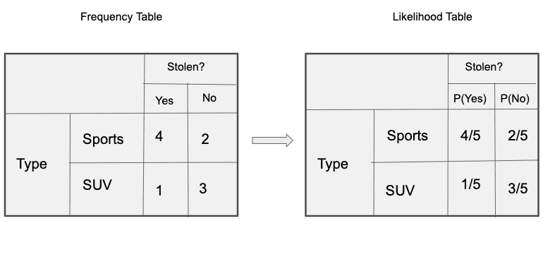
Naïve Bayes Example
‹#›
Frequency and Likelihood tables of ‘Type’
Notes:
Optimisation of the Beer Distribution Game
‹#›

Slide 13
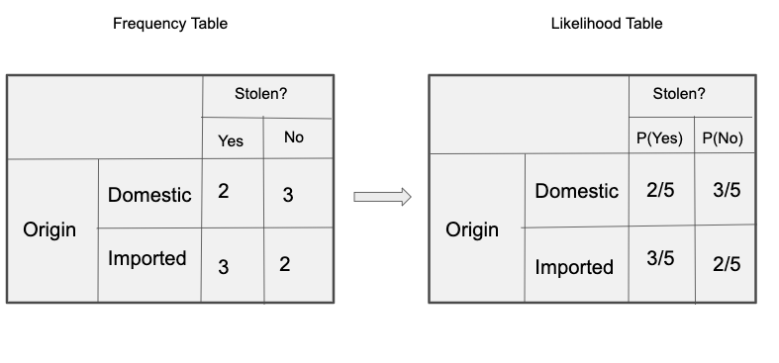
Naïve Bayes Example
‹#›
Frequency and Likelihood tables of ‘Origin’
Notes:
Optimisation of the Beer Distribution Game
‹#›

Slide 14

Naïve Bayes Example
‹#›
So in our example, we have 3 predictors X.
we can calculate the posterior probability P(Yes | X) as
P(Yes|Red,SUV,Domestic) = P(Red|Yes)* P(SUV|Yes) * P(Domestic|Yes)* P(Yes)
= ⅗ * ⅕ * ⅖ * 0.5
= 0.024
P( No | X ) as
P(No|Red,SUV,Domestic) = P(Red|No)* P(SUV|No) * P(Domestic|No)* P(No)
= ⅖*⅗ * ⅗ * 0.5
= 0.072
Since 0.072 > 0.024, Which means given the features RED SUV and Domestic, our example gets classified as ’NO’ the car is not stolen.
Notes:
Optimisation of the Beer Distribution Game
‹#›

Slide 15
Advantages and Disadvantages of Naïve Bayes Classifier
‹#›
Advantages of Naïve Bayes Classifier:
Naïve Bayes is one of the fast and easy ML algorithms to predict a class of datasets.
It can be used for Binary as well as Multi-class Classifications.
It performs well in Multi-class predictions as compared to the other Algorithms.
It is the most popular choice for text classification problems.
Disadvantages of Naïve Bayes Classifier:
Naive Bayes assumes that all features are independent or unrelated, so it cannot learn the relationship between features.
Notes:
Optimisation of the Beer Distribution Game
‹#›

Slide 16
Applications of Naïve Bayes Classifier
‹#›
It is used for Credit Scoring.
It is used in medical data classification.
It can be used in real-time predictions because Naïve Bayes Classifier is an eager learner.
It is used in Text classification such as Spam filtering and Sentiment analysis.
Notes:
Optimisation of the Beer Distribution Game
‹#›

Slide 17
Example Link: https://www.geeksforgeeks.org/machine-learning/naive-bayes-classifiers/

Slide 18
Example
A group of university students is conducting research on email classification to improve spam detection systems. Over the course of their study, they analyzed 1,500 emails, of which 900 were identified as spam and the remaining 600 were classified as not spam (ham). Among the spam emails, 270 contained the word “free,” while 30 of the non-spam emails also included this word. Based on this data, determine the probability that an email is spam given that it contains the word “free.”

Slide 19
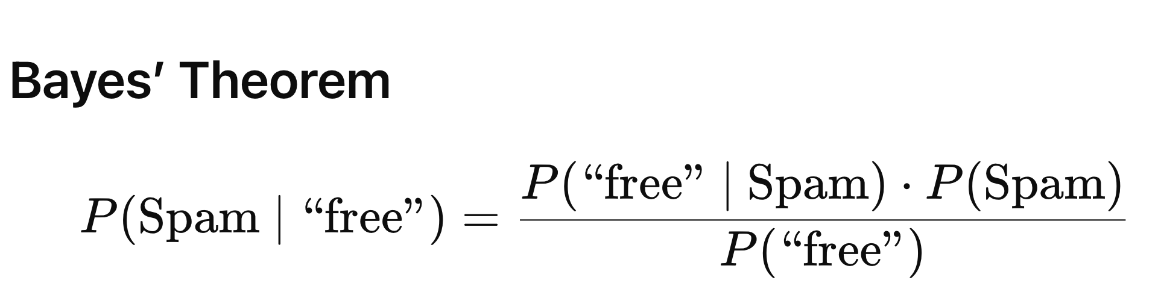
Answer

